Slide 1


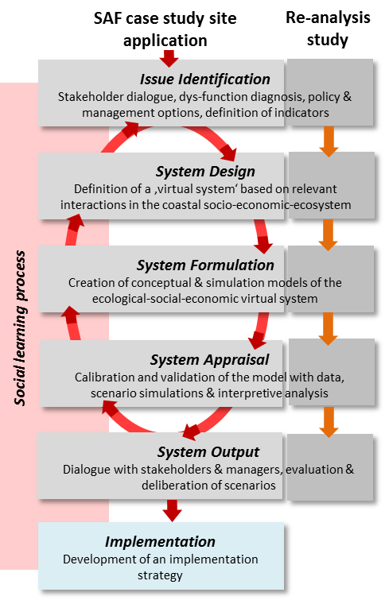


Title Example 2
Author 1 | Author 2 | Author 3 | Author 4
Author 1 (Institute, city, country)
Author 2 (Institute, city, country)
Author 3 (Institute, city, country)
Author 4 (Institute, city, country)
Systems Approach Framework (SAF)
Heading
Systems Theory is about understanding complex and large-scale interactions based on our perceptions of the world. It requires broad multi-disciplinary experience as is represents a mixture of scientific knowledge and intuition needed to understand the behaviour of complex systems (Hopkins et al. 2011).
Text.
Systems Theory is about understanding complex and large-scale interactions based on our perceptions of the world. It requires broad multi-disciplinary experience as is represents a mixture of scientific knowledge and intuition needed to understand the behaviour of complex systems.
Heading
Text.
Figure 1: Diagram or map with explanation
Heading
Text.
Heading
Text.
Acknowledgements:
BONUS xxx project has received funding from BONUS (Art 185), funded jointly by the EU and [national funding institution acknowledgements, as appropriate].

